Slide 1


The existential threat to public schools.
William L. Phillis
Executive Director, Coalition of Equity & Adequacy for School Funding

Slide 2
Eric Resnick, at Charlie Wilson’s advice, approaches E&A Coalition to discuss potential lawsuit.
February 2020
February-May 2020
Meetings held to gauge interest
OSBA engages Brickler & Eckler law firm to look into the viability of constitutional claims.
E&A Steering Committee takes up lawsuit discussion, adopts revised bylaws and begins working toward lawsuit.
May 28, 2020
August 17, 2020
RFP sent to 38 law firms.
Precision New Media hired to coordinate communications strategies.
August 24, 2020
September 2020
3 law firms submitted proposals.
December 8, 2020
Walter | Haverfield selected as law firm.

Slide 3
STEERING COMMITTEE MEMBERS
Richard Murray, Chairman—Executive Director of CORAS
Vaughn Bell, Westerville City School District BOE; minister
Linda Blum, Northmont City Schools BOE, President
Eric Brown, Columbus City Schools BOE; former Chief Justice of the Ohio Supreme Court
Michael Collins, Business owner; former Westerville and State Board of Education member
Steve Dyer, OEA Director of Government Relations, Communications and Marketing
Dan Heintz, Cleveland Heights | University Heights BOE; teacher Chardon City Schools
Cathy Johnson, Southwestern City Schools BOE; retired teacher; former president of OSBA
Tom Perkins, Deputy Executive Director BASA
Eric Resnick, Canton City School District BOE
Bob Smith, Retired school administrator
Andy Wilson, Fairborn City Schools BOE
Charlie Wilson, Worthington City Schools BOE; OSU law professor; former OSBA and NSBA president
Donna Wilson, Fairborn City Councilwoman; retired teacher
Rick Vilardo, Ex-officio, Westerville City School District BOE; minister

Slide 4
What makes the EdChoice voucher program unconstitutional?
Ohio Constitution Article VI, section 2:
“§2 The General Assembly shall make such provisions, by taxation, or otherwise, as, with the income arising from the school trust fund, will secure a thorough and efficient system of common schools throughout the State; but, no religious or other sect, or sects, shall ever have any exclusive right to, or control of, any part of the school funds of this State.”
Only place in the Ohio Constitution that provides a function by taxation.
Vouchers and charter schools do not fit the mold of the common school system.
By funding vouchers and charter schools, the state has not complied with Ohio Supreme Court orders to fully fund public schools.

Slide 5
Ohio Supreme Courts rules school funding system unconstitutional in…
1997
$25 Billion
to vouchers and
charters since 2000.
2000
2001
2002

Slide 6

Ohio Voucher Program Costs
2002-2018
2002
EdChoice began as a pilot program
$650 M
$600 M
$550 M
$500 M
$450 M
$400 M
$350 M
$300 M
$250 M
$200 M
$150 M
$100 M
$50 M
0
Since FY 2008 the voucher deduction from school districts has increased from:
2002
2003
2004
2005
2006
2007
2008
2009
2010
2011
2012
2013
2014
2015
2016
2017
2018
$42
MILLION
in 2008
$650
MILLION
this fiscal year
The program nearly doubled in the current budget cycle alone.
Source: Innovation Ohio Education Funding Report
Notes:
Grown from $42 Million to $650 Million
The program nearly doubled in the current budget cycle alone.

Slide 7
State GRF began increasing with filing of DeRolph in 1991.
By 2002, 35-38.9% of the GRF.
2002-2009, increased to 40.7% of GRF and has stayed above 40%.
FY2023 - 40.2%.
The increase in revenue has been to charter and voucher schools that have been given $25 billion.
The pool for K-12 common public schools has shrunk.

Slide 8
Vouchers remove funds from the pool of funds allotted for K-12 education, thereby reducing funds to school districts.
ISSUES
Vouchers promote or exacerbate segregation of students by class and race.
Vouchers are given a funding priority over the public school districts.
Private schools are not accountable for public funds they receive. They are not held to the same standards.
Weakens STRS pension fund.
Stability of STRS at risk - 12 cents of every dollar spent in public schools ends up in STRS and retirement systems.

Slide 9
TWO-YEAR STATE BUDGET
Accelerated privatization of public education
High School vouchers - $7,500
Elementary - $5,500
Cap on vouchers removed
Tuition tax credit - $750
Homeschool tax credit - $250
$500 ESAs for parents
Siblings and foster children eligibility

Slide 10
TWO-YEAR STATE BUDGET
WHAT THEY DIDN’T DO:
Fund public schools
Left out critical 6-year phase-in to make funding formula for public schools constitutional, known as Cupp/Patterson

Slide 11




Slide 12

WHAT’S NEXT?
The Future of Vouchers
Ohio is the wild west of vouchers.
Two-year state budget grows voucher
program exponentially.
Lawmakers pushing universal voucher plan.

Slide 13

THE REALITY
Vouchers have become a refund and rebate program draining precious dollars from your schools.
LACK OF ACCOUNTABILITY
UNREGULATED

Slide 14
HB 290
UNIVERSAL VOUCHERS
Every child.
Every school.
Voucher Eligible.

Slide 15
HB 290
UNIVERSAL VOUCHERS
Money follows the student
Bureaucracy in state treasurer’s office
No accountability
No oversight
Destroys public schools

Slide 16

FY 2021
215 Coalition members
74 VHO members
FY 2022
193 Coalition members
93 VHO members

Slide 17

MISSION
Vouchers Hurt Ohio is a growing coalition of public school districts that have come together to sue the state over the unconstitutional and harmful private school voucher program.

Slide 18

TWO-PRONGED APPROACH
Court of Law
Court of Public Opinion

Slide 19


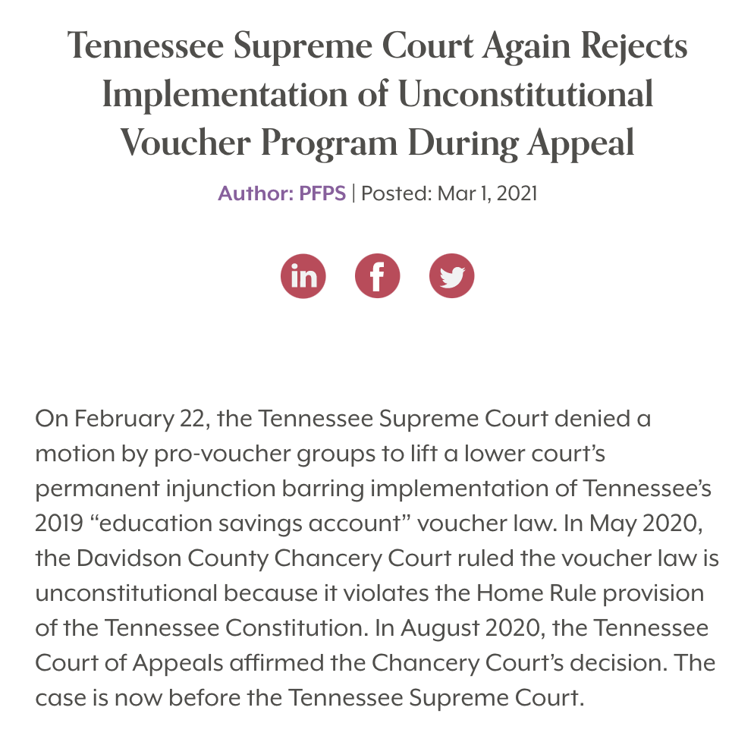
We are not in this alone.

Slide 20
COURT OF PUBLIC OPINION

Slide 21

Website
Notes:
http://vouchershurtohio.precisionnewmedia.com/
https://www.georgiademocrat.org/voting-information-and-resources/early-voting/

Slide 22



Not on the list?
Keeping you informed.
Go to vouchershurtohio.com and go to SIGN UP.
Or click on the pop up window.
Every Tuesday at 10:00 a.m. we send out an email to keep everyone updated.

Slide 23


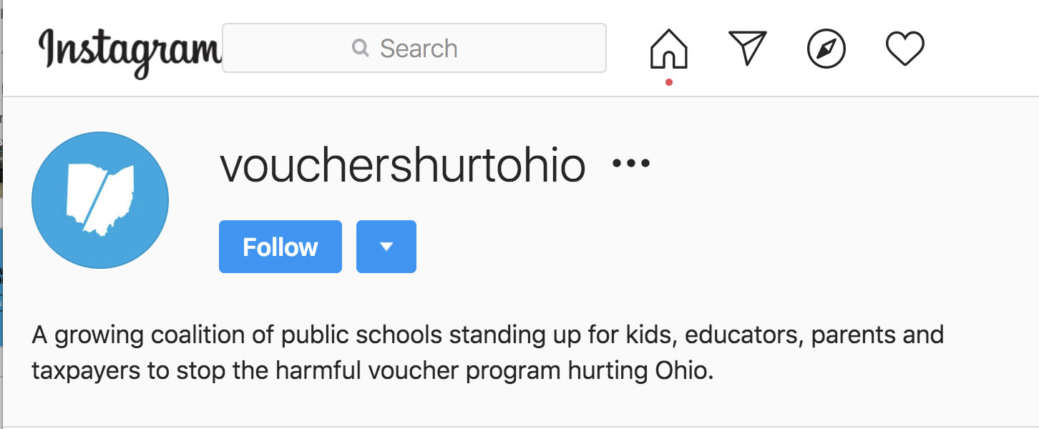
Social Media
Notes:
We have Facebook, Twitter and Instagram

Slide 24


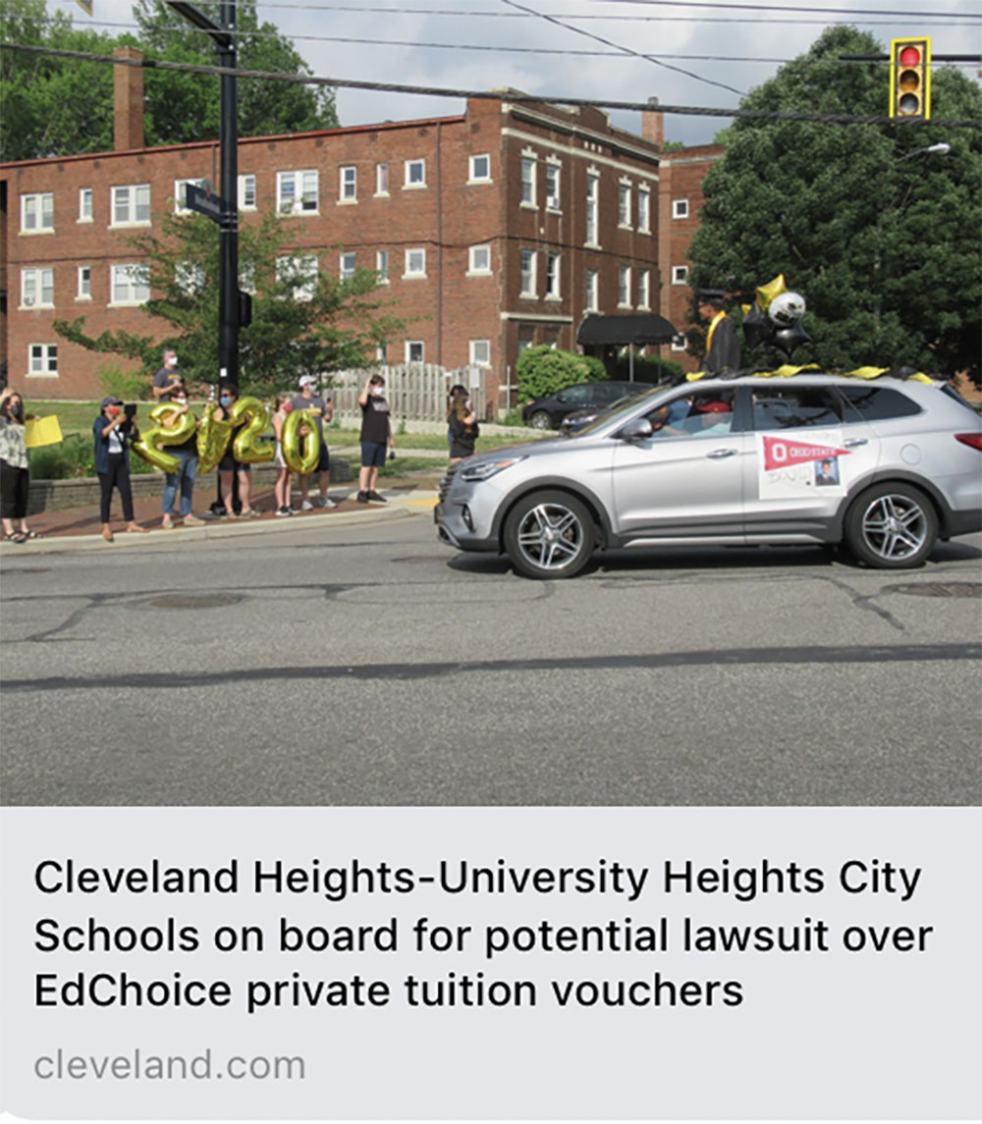
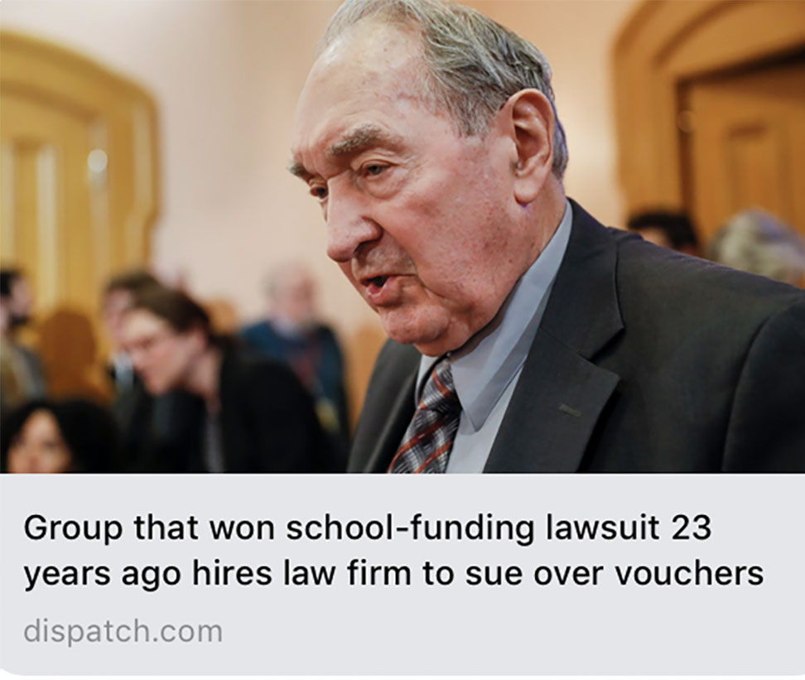
Earned Media
Create opportunities for media attention.
Here are some examples of earned media so far. These will always be shared on social media and the website.
Media relations
Foster local media relations to keep the conversation going.
Highlight districts
that have joined
We will begin this right away.

Slide 25

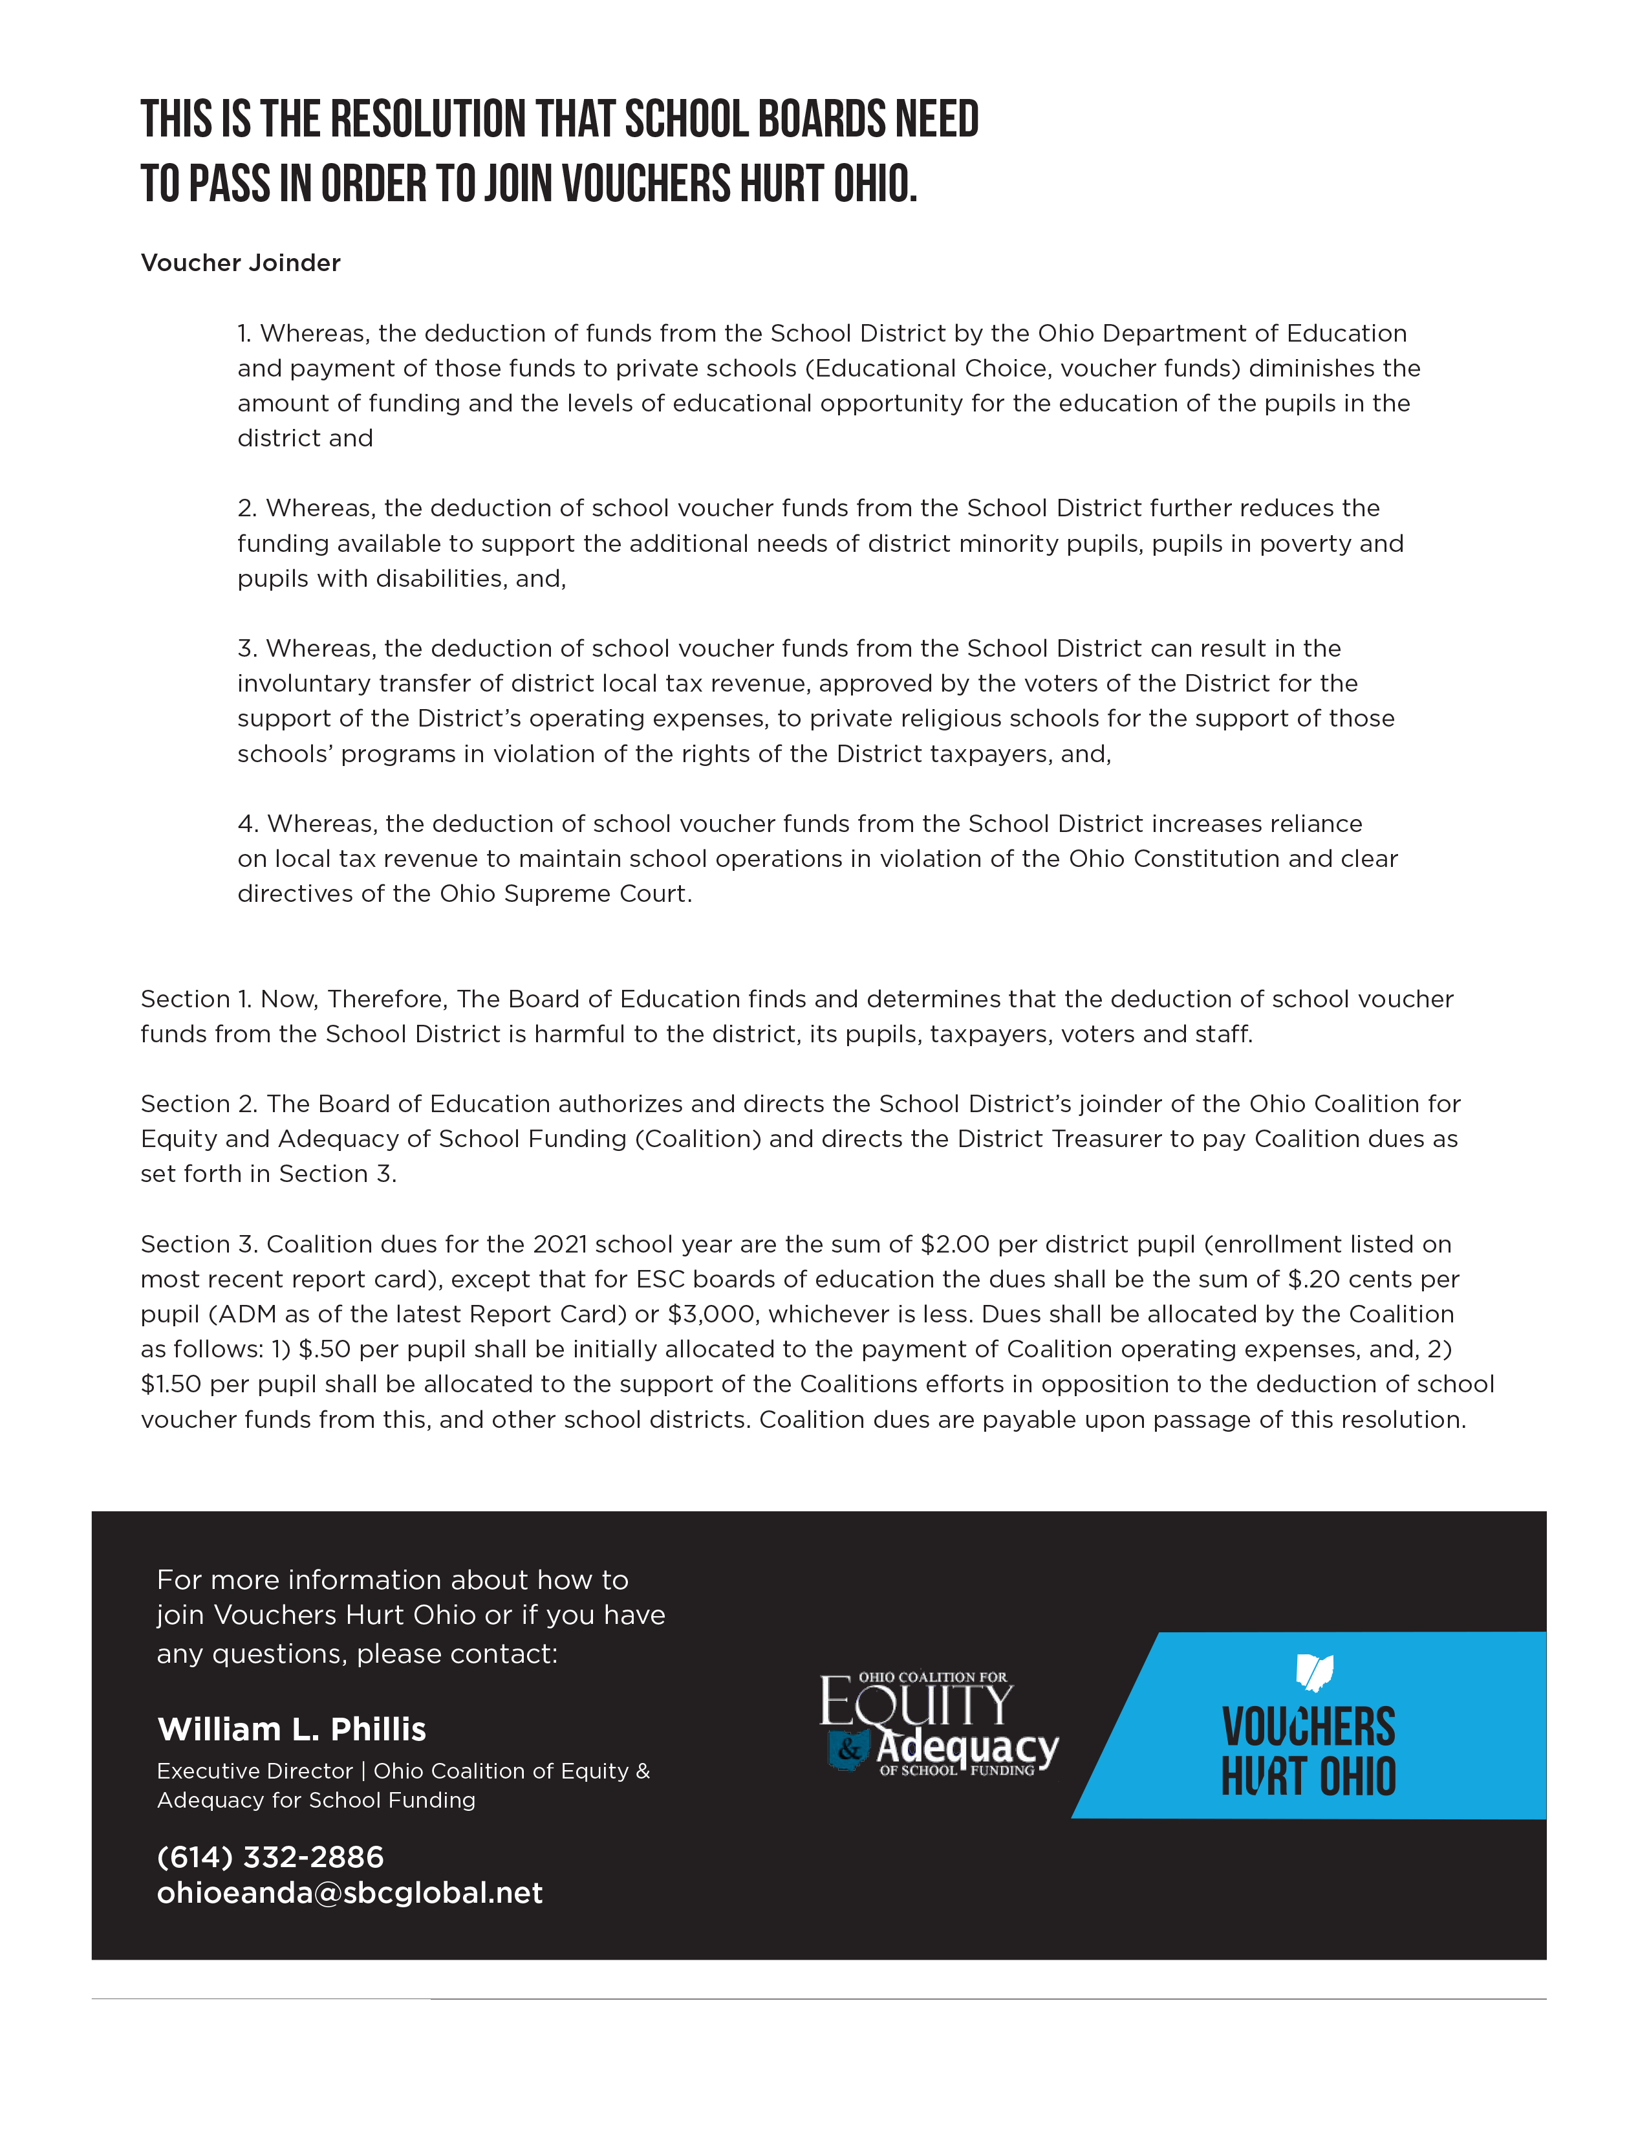

How to join Vouchers Hurt Ohio

Slide 26
$0.50
Per year per student
$1.50
Per year per student
Pays for coalition operating expenses, legal and public relations fees.

Slide 27
Join us.
If you want more information about how to join Voucher Hurts Ohio or have any questions, please contact:
William L. Phillis
Executive Director,
Coalition of Equity & Adequacy
for School Funding
614.228.6540
ohioeanda@sbcglobal.net
Notes:
Resolution and steps it takes to join

Slide 28
    QUESTIONS?

